Slide 1
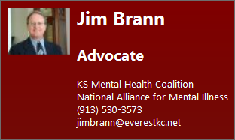
Is it Just About the Numbers?
Mental Illness’ Impact on Kansans
Presented by Jim Brann
Advocate
For Kansas Mental Health Coalition

Slide 2
Introduction
I am Jim Brann, a member of Kansas Mental Health Coalition (KMHC) and Kansas National Alliance for Mental Illness (NAMI). I am a Grassroots Advocate.
It’s 3am, Sunday November 3, 2013. “Dad, it’s me, Billy. I’m out.”
Billy was released from Sedgwick County Detention Center in Wichita at midnight. He’s dressed in a tee-shirt, shorts and flip flops. He was released because his probation was completed and they needed his bed.
No money, no clothes, no place to go. He called me using the phone of a clerk at a near-by QuikTrip.
I’m here to talk about Mental Health, Costs and what YOU can do.

Slide 3
Kansas Mental Health Coalition
KMHC Website: http://kansasmentalhealthcoalition.onefireplace.com/
KMHC is a collaborative organization of numerous non-profit organizations, agencies and individuals representing consumers, families, and providers dedicated to improving the lives of Kansans with mental illness.
Within the format of monthly roundtable meetings, participants forge a consensus agenda which provides the basis for public education and advocacy efforts each year.
The organization facilitates communication within the Kansas mental health system regarding developing needs and updates on programs and issues.

Slide 4
Kansas Numbers
18% of Kansans are mentally ill
38% of Incarcerated Kansans are mentally ill
88% of Crime by Veterans is Violent
$1.7B Annual costs for Untreated Mental Illness
$600M Annual costs to Business for Untreated Mental Illness
$715M Annual costs to Individuals & Families For Untreated Mental Illness
65% cumulative decrease in KS MH budget, FY07 –FY12

Slide 5
Kansas Per Day Costs
For Treatment:
$428 day in State Psychiatric Hospital
$292 in Psychiatric Residential Treatment Facility
$80 at Larned Correctional Mental Health Facility
$9 for Medicaid reimbursed community treatment
Incarceration per inmate:
$67 in State Prison
$118 in Johnson County Detention Center
$92 in Wyandotte County Detention Center

Slide 6
Is it Just About the Numbers?

Slide 7
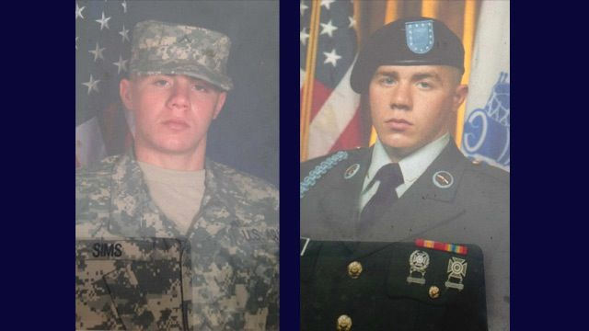
Isaac Sims, 26, a third-generation Army infantryman was shot and killed by
police on Memorial Day this year after he pointed an AK-47 at them.
Post traumatic stress disorder, migraines and depression forced the damaged
soldier with traumatic brain injuries and little hearing to reach out to the
Veterans' Administration for help, but was turned away. VA officials told the family it would take a month or more just to make a first contact to help Isaac -- if a bed was available.
"He's fallen through the cracks and he's dead now," his grieving mother said at the time.

Slide 8
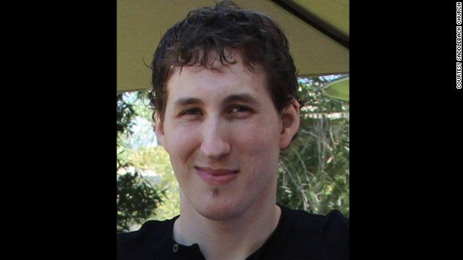
Matthew Warren, 27, committed suicide "in a momentary wave of despair. Mental Illness took our sons life, as it did many of the 38,000 other Americans who took their lives last year but we refuse to let his life just be another statistic,” said Pastor Rick Warren.
"Unfortunately, he also suffered from mental illness resulting in deep depression and suicidal thoughts. “
This spring, an historic, first time gathering of leaders met for an all day Gathering For Mental Health and the Church” to discuss the importance of churches working together to address critical mental health issues. More than 3,000 attended and it received national and international coverage.
Source: Alan Duke, CNN , Mon April 8, 2013 and Katrina Gay, nami Advocate Magazine, Summer 2014

Slide 9
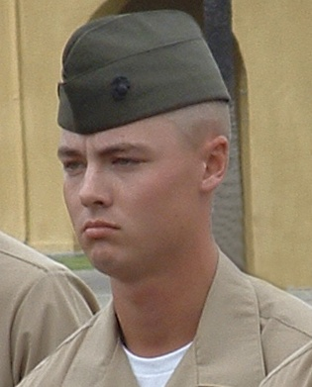
My son Billy is a decorated Marine. He served two tours in Iraq including fierce combat at Ramadi, Fallujah and Al Quam.
He is suffering from Post Traumatic Stress Disorder and Major Depressive Disorder with Psychotic Features with Paranoia and thoughts of Suicide.
He has been in and out of the KS Criminal Justice System the last 5 years. He is currently on probation, works at two jobs, and is receiving Therapeutic Mental Health Care.

Slide 10
What You Can Do?
Advocate for Mental Health
  Get training – 8 hours by KMHC
  Meet with your KS Representative and Senator
  Engage the Governor
Fight against the stigma of Mental Illness
  Get educated http://www.nami.org/Template.cfm?Section=Fight_Stigma&Template=/TaggedPage/TaggedPageDisplay.cfm&TPLID=77&ContentID=42780
  Voices of NAMI http://www.nami.org/template.cfm?section=In_Our_Own_Voice
  Spread the word
Support Law Enforcement Crisis Intervention Teams
  Learn about CIT http://www.nami.org/template.cfm?template=/contentManagement/contentDisplay.cfm&contentID=35547
  Provide funding to KMHC to directly support CIT program development
Provide support to KMHC – Corporate & Individual Sponsorships
  Participate in Executive Round-tables
  Provide input about your issues and concerns
  Provide funding to support KMHC programs and processes

Slide 11
Next Steps
Meet with Executive Teams
Meet with Employee Groups
Setup training programs
QUESTIONS

Slide 12
Appendix
Supporting Documentation

Slide 13
Corporate Sponsorships
Platinum
  Annual contribution to KMHC of $50,000
  Joint News Release
  Honorary membership on KMHC Board of Directors
  Corporate Link on KMHC Website
  Listed as a Platinum Corporate Sponsor on KMHC Website
  Participation in KMHC semi-annual Round-tables
  50 Logo’d Gear Premium “Corporate / KMHC” Golf Shirts
Gold
  Annual contribution to KMHC of $25,000
  Corporate Link on KMHC Website
  Listed as a Gold Corporate Sponsor on KMHC Website
  Participation in KMHC semi-annual round-tables
  25 Logo’d Gear Premium “Corporate / KMHC” Golf Shirts
Silver
  Annual contribution to KMHC of $10,000
  Listed as a Silver Corporate Sponsor on KMHC Website
  Participation in KMHC semi-annual round-tables
  10 Logo’d Gear Premium “Corporate / KMHC” Golf Shirts
Bronze
  Annual contribution to KMHC of $5,000
  Listed as Bronze Corporate Sponsor on KMHC Website
  5 Logo’d Gear Premium “Corporate / KMHC” Golf Shirts
http://logodgear.com/ More Shirts available for purchase

Slide 14
Individual Sponsorships
Board of Director’s Sponsor
  Annual contribution to KMHC of $2,500 or more
  Honorary membership on KMHC Board of Directors
  KMHC Membership
  Listed as a Board of Directors Individual Sponsor on KMHC Website
  Participation in KMHC semi-annual Round-tables
  Logo’d Gear Premium “Personalized KMHC” Golf Shirt
President’s Sponsor
  Annual contribution to KMHC of $1,500 to $2,499
  KMHC Membership
  Listed as a President’s Individual Sponsor on KMHC Website
  Participation in KMHC semi-annual round-tables
  Logo’d Gear Premium “Personalized / KMHC” Golf Shirt
Individual Sponsor
  Annual contribution to KMHC of $1,000 to $1.499
  KMHC Membership
  Listed as an Individual Sponsor on KMHC Website
  Participation in KMHC semi-annual round-tables
  Logo’d Gear Premium “Personalized / KMHC” Golf Shirt
http://logodgear.com/ More Shirts available for purchase

Slide 15

Percentage of Population with Mental Illness, Incarcerated and Veterans
Study Summary – Heartland States & US (Part 1)
State Population (millions)
  Average 4.6; Colorado 5.3, Iowa 3.1, Kansas 2.9, Nebraska 1.9, Missouri 6.1, Oklahoma 3.9
Number of Inmates
  Average 16,416; Colorado 17,699, Iowa 8,069, Kansas 9,580, Missouri 31,513, Nebraska 5,097, Oklahoma 26,539
Average Daily Cost per Inmate
  Average $61.18; Colorado $60.00, Iowa $90.81, Kansas $67.14, Missouri $56.81, Nebraska $89.36 Oklahoma $47.87
Percentage of the Population who are Mentally Ill
  Average 19; Colorado 18, Iowa 18, Kansas 18, Nebraska 18, Missouri 19, Oklahoma 22
Percentage of Incarcerated Population who are Mentally Ill
  Average 33; Colorado 29, Iowa 47, Kansas 38, Missouri 16, Nebraska 37, Oklahoma 33

Slide 16
Percentage of Population with Mental Illness, Incarcerated and Veterans
Study Summary – Heartland States & US (Part 2)
6. Percentage of Population Incarcerated who are Veterans
  Average 7; Colorado 9, Iowa 6, Kansas 8, Missouri 7, Nebraska 3, Oklahoma 6
7. Percentage of Incarcerated Veterans who are Mentally Ill
  Average 44; Colorado 33, Iowa 50, Kansas 66, Missouri 18, Nebraska 60, Oklahoma 35
8. Percentage of Incarcerated Mentally Ill Veterans with Less than an Honorable Discharge (no data for Nebraska and Oklahoma)
  Average 21; Colorado 22, Iowa 4, Kansas 10, Missouri 46
9. Percentage of Incarcerated Mentally Ill Veterans convicted of Violent Crime
  Average 68; Colorado 66, Iowa 53, Kansas 84, Missouri 64, Nebraska 95, Oklahoma 45
10. Data for the United States as a whole
  2013 Population 316.1M, Number of Inmates 731,208, Average Daily Cost per Inmate >$60, Percentage of Population Mentally Ill 18; No data on Percentage of Mentally Ill who are incarcerated; No Data on Mentally Ill or Incarcerated Veterans

Slide 17
Percentage of Population with Mental Illness, Incarcerated and Veterans
Study Summary – Kansas Counties

Slide 18
Percentage of Population with Mental Illness, Incarcerated and Veterans
The Cost of Mental Illness Treatment
Cost of Mental Health Treatment
On average, per day, it costs:
$428 at a State Psychiatric Hospital
$292 at a Psychiatric Residential Treatment Facility
$80 at Larned Correctional Mental Health Facility
$9 for Medicaid reimbursed community treatment
Incarceration:
Paying for the costs of treating mental illness is unavoidable!
Our only decision is how we as a State pay for it.
Sources: Association of Community Mental Health Centers of Kansas 2012 Testimony , 2013 KDOC Annual Report and KS County Sheriffs

Slide 19
Percentage of Population with Mental Illness, Incarcerated and Veterans
The Cost of Untreated Mental Illness
Health Care Foundation of Greater Kansas City 2012 Study
  “The Costs of Untreated Mental Illness in Greater Kansas City”
Study quotes:
  A high proportion, 87.5%, of these costs is in the form of indirect costs to employers and individuals. Indirect costs include unrealized earnings due to higher unemployment rates, the cost of lost productive time at work due to untreated SMI (presenteeism), time missed from work (absenteeism), and unrealized earnings due to permanent disability or premature death (suicides)
  Those with severe mental illness are 10 times more likely to become incarcerated compared to the general population.
  One barrier might be reluctance to consider mental illness on par with physical illnesses. However, in the Surgeon General’s report on mental health, major depression was the second-leading source of disease burden worldwide, behind only heart disease.
  Some might argue that state and local governments cannot afford to improve the treatment rate of the seriously mentally ill. This economic model shows that improving the treatment rate for the mentally ill is something they cannot afford to ignore.
Source: HCFGKC: http://hcfgkc.org/costs-untreated-mental-illness and US Census Bureau 2013 Estimates for KS

Slide 20
Percentage of Population with Mental Illness, Incarcerated and Veterans
The Cost of Untreated Mental Illness

Slide 21
Percentage of Population with Mental Illness, Incarcerated and Veterans
The Cost of Untreated Mental Illness

Slide 22
Percentage of Population with Mental Illness, Incarcerated and Veterans
The Cost of Untreated Mental Illness

Slide 23
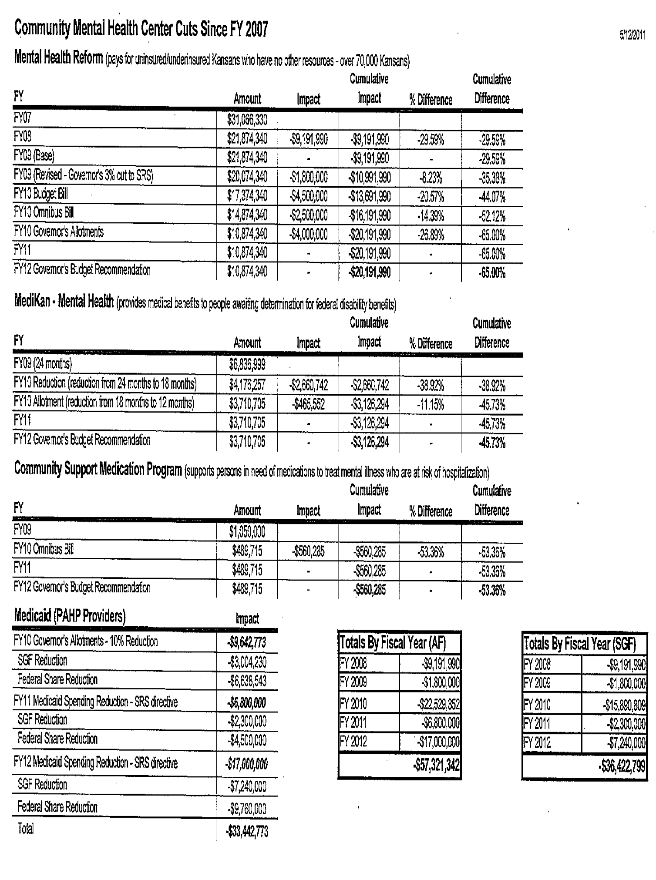
Mental Health and Criminal Justice System
Source Synopsis

Slide 24
Mental Health, Incarceration and Veterans
Studies & News
Studies
Orange County Ground Breaking Event
CIT Training Overview
Apprehension by a Police Officer without a Warrant
Help for Veterans Involved in the Justice System
Mercer Report-State of KS.pdf
West Virginia Survey of Veterans – Final Report 2012
Validation of Self-reported Veteran Status Among Two Homeless Groups
The Costs of Untreated Mental Illness in Greater Kansas City
News
Suicide Rates Climb by 30% as Kansas Cuts Budgets
Home From War, Our Soldiers Continue to Die
Brownback: Society Needs to Handle Mental Illness as Treatable Disease
Improve Mental Health Care for Our Veterans
Veteran’s Father Fights for More Treatment Less Jail Time for Mentally Ill
Brownback Outlines Plans to Improve Mental Health Services for Mentally Ill Kansans
Veteran Shot Dead by Police after he was Refused Psychiatric Care by Kansas City VA
Kansas City VA also had Secret List
Huge Backlog – VA Audit Show VA Uses Secret Lists
Kansas Citians Push to Remove Stigma of Mental Illness
State Funding for Mental Health Lagging

